Slide 1



Rethinking TRIZ for
AI-Driven Narrative Generation
Cosimo Palma · Bertrand Jager
University of Pisa, Italy · ArchiveMyLegacy, Luxembourg
Text2Story'26 — ECIR 2026, Delft

Slide 2






Outline
1
TRIZ × Narratology
Common ground: contradiction as engine of invention and story
2
Narrative Contradiction Matrix
24 parameters, 40 devices, and the 24×24 matrix
3
RDF-Star Ontological Representation
Formal encoding enabling SPARQL-based narrative rule retrieval
4
Human-in-the-Loop Workflow
7-step TRIZ protocol for structured creative problem-solving
5
Agentic Deployment: ArchiveMyLegacy
Proactive TRIZ agent monitoring narrative health in the AML pipeline
6
Concluding Remarks
Future experimental programme

Slide 3





The TRIZ Framework
Theory of Inventive Problem Solving
Genrich Altshuller · Developed from 1940s onward · Systematic analysis of 400,000+ patents across diverse engineering fields
Contradictions
ARIZ Algorithm
Technical: improving one parameter degrades another. Physical: a single parameter must satisfy two incompatible requirements. Identifying the active contradiction is the first and most critical step.
An elaborate analytical procedure for complex cases where the matrix provides insufficient guidance, plus patterns of technical system evolution (toward dynamism, micro-level, etc.).
40 Inventive Principles
Function Analysis & Substance-Field Models
High-level solution strategies (Segmentation, Inversion, Dynamics, Preliminary Action…) that recur across domains. They operate at a level of abstraction that enables cross-domain analogical transfer.
Graphical tools for modelling functional interactions between components identifying harmful, insufficient, or excessive interactions at the root of the design problem.
39 × 39 Contradiction Matrix
Key insight: TRIZ transforms creative problem-solving from intuition to methodology, which is precisely what makes it attractive for computational applications.
Rows = parameter to improve, Columns = parameter that worsens. Each cell contains two principles most frequently effective for that trade-off in the patent corpus.
Altshuller, G. (1973). The Innovation Algorithm. Technical Innovation Centre, Inc., 2007.

Slide 4


Why TRIZ × Narratology?
TRIZ (Engineering)
Narratology
Contradictions drive all inventive problems
40 Inventive Principles distilled from 400K+ patents
39×39 Contradiction Matrix maps problem → solution strategies
Conflict is the generative core of story
Both fields revolve around structured tension
Existing TRIZxNarratology work is limited & pre-LLM

Slide 5

Contributions
Narrative Contradiction Matrix
24×24 matrix mapping parameter trade-offs to 40 narrative devices, grounded in classical narratological theory
RDF-Star Ontology
Formal knowledge representation enabling SPARQL-based narrative rule retrieval and cross-parameter reasoning
Human-in-the-Loop Workflow
7-step TRIZ protocol for structured creative problem-solving, positioning the LLM as dramaturgical consultant
Proactive Agentic Architecture
ArchiveMyLegacy deployment: TRIZ-agent monitors narrative health and intervenes before contradictions become failures

Slide 6
24 Narrative Parameters
Six dimensions covering the full narrative design space
Plot (1–6)
World & Setting (17–18)
Narrative Pace, Plot Complexity, Causal Clarity, Suspense/Tension, Resolution, Timeline
World-building, Thematic Coherence
Character (7–12)
Reader Engagement (19–22)
Depth, Agency, Believability, Relatability, Transformation, Consistency
Emotional Eng., Intellectual Eng., Accessibility, Memorability
Information Management (13–16)
Communicative (23–24)
Inf. Density, Historical Coherence, Clarity, Surprise
Educational Value, Entertainment Value

Slide 7
40 Narrative Devices (Selection)
Each device is theoretically grounded in classical narratological sources
1. Mistaken Identity
13. Chekhov's Gun
35. Ironic Outcome
Aristotle
McKee
Booth
6. Sacrificial Choice
20. Temporal Displacement
39. Cathartic Release
Campbell
Genette
Aristotle
9. Ticking Clock
28. Historical Witness
40. Echo Effect
McKee
Genette
Chatman
10. Sudden Reversal
33. Moral Dilemma
14. Interrupted Journey
Aristotle
Booth
Campbell

Slide 8
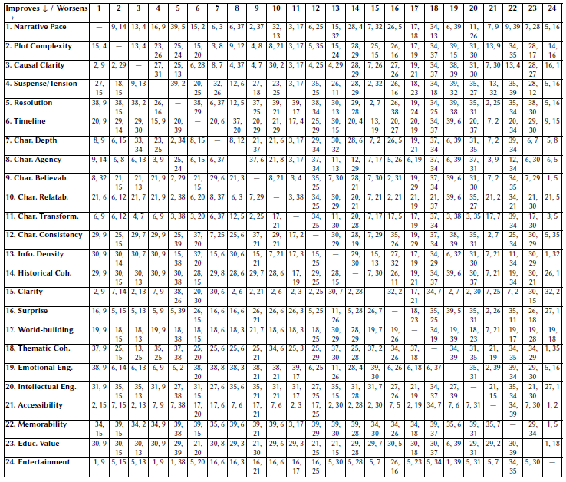
The Narrative Contradiction Matrix

Slide 9
The Narrative Contradiction Matrix
How It Works
Reading Example
Rows = parameter to improve
Columns = parameter that worsens
Each cell contains indices of narrative devices (from the 40-device table) that can mediate the specific trade-off.
24 × 24 = 552 non-diagonal cells,
each with 2 recommended devices.
Row 1 (Narrative Pace) × Col 2 (Plot Complexity)
→ Devices: (9) Ticking Clock, (14) Interrupted Journey
"When improving Narrative Pace risks degrading Plot Complexity, these devices are recommended mediators. the Ticking Clock sustains pace while preserving complexity through urgency; the Interrupted Journey introduces sub-plots that re-inject complexity without disrupting rhythm."

Slide 10
RDF-Star Ontological Representation
Schema Formalization and RDF-Star Encoding
SPARQL query example
P = {p₁…p₂₄} Narrative Parameters
D = {d₁…d₄₀} Narrative Devices
R = {improves, worsens, SolvedbyMeansOf}
C ⊆ P × R × P (Narrative Compounds)
NR ⊆ C × 2ᴰ (Narrative Rules)
<< :NarrativePace
:worsens
:PlotComplexity >>
:SolvedByMeansOf :TickingClock ;
:SolvedByMeansOf :InterruptedJourney .
SELECT ?device WHERE {
<< :NarrativePace
:worsens
:PlotComplexity >>
:SolvedByMeansOf ?device .
}
While elementary queries could be answered by direct matrix consultation, the expressive capacity
of this schema extends well beyond simple lookups: one could query for all devices that mediate a
specific parameter across multiple trade-off directions, or perform a reverse look-up (“given this device,
which contradictions can it resolve?”) particularly useful in story diagnosis.

Slide 11

Human-in-the-Loop Workflow
LLM as dramaturgical consultant — preserving human creative agency
1
2
3
4
5
6
7
Bottleneck
Detection
Contradiction
Articulation
Contradiction
Mapping
Principle
Retrieval
Ideation
Dialogue
Implementation
Support
Reflection &
Learning
↻ Cycle repeats as new bottlenecks emerge
Example
Writer: "I need backstory for stakes, but it kills pacing."
System maps: improving Suspense (p.4) worsens Pace (p.1) → Cell (4,1) = devices (9, 10)
→ Ticking Clock and Sudden Reversal suggested as mediators.

Slide 12

Proactive TRIZ Agent: ArchiveMyLegacy
Inverting the collaboration: the agent monitors narrative health and advises the writer
Photo Input
Narrative State Monitor
↓
↓
Entity & Relation
Extraction
draft state →
Contradiction Detector
↓
↓
LLM Story Draft
Matrix Look-up &
Device Retrieval
↓
← device suggestion
↓
Final Narrative
Proactive Writer Prompt
Domain: biographical narratives from photos — constrained by real events yet requiring dramaturgical shape.

Slide 13

Proactive TRIZ Agent: ArchiveMyLegacy
Example Agent Intervention
Scenario: Historical Coherence (p.14) compresses Narrative Pace (p.1)
"The current draft allocates significant space to historical context (param. 14: Historical Coherence is high), which is beginning to compress Narrative Pace (param. 1). Table 3 cell (14, 1) suggests devices (28: Historical Witness) or (4: Fateful Encounter) as mediators. Would you like the system to introduce a scene in which a family member narrates the historical context through a personal encounter, thus embedding exposition in action?"

Slide 14

Proactive TRIZ Agent: ArchiveMyLegacy
Experimental Sketch & Narrator Development
Expected Outcomes
Inventiveness & Memorability — significant improvement C0 → C2
Emotional Engagement — smaller positive effect
Coherence — possible non-monotonic dip (C1 > C0; C2 may show temporary complexity overhead = learning curve)
Experiment Design
Within-subjects, 3 conditions, N = 30
C0 No TRIZ layer
C1 One TRIZ device suggestion per session
C2 Full proactive agent (all 24 parameters)
3 raters blind to condition · 5 criteria · 1–5 Likert
Reliability: Krippendorff's α
Narrator Skill Development
Step 2 (Contradiction Articulation) requires the writer to explicitly name structural tensions, a metalinguistic act grounded in Vygotskian mediated learning. Repeated use may develop structural narrative literacy: the internalized ability to perceive and manipulate narrative trade-offs.

Slide 15

Concluding Remarks
TRIZ fills the LLM gap
LLMs lack explicit reasoning about contradictions and trade-offs. TRIZ provides exactly this structured, transparent problem-solving layer.
Multi-scale applicability
From resolving micro-level dramatic contradictions within scenes, to generating synopses and discovering novel plot architectures at the macro level.
Narrative dramaturg
The proactive agent inverts human–AI collaboration: the AI monitors narrative health and intervenes before dysfunction becomes apparent.
Beyond the artifact
TRIZ-assisted co-writing may function as a vehicle for narrative education — developing structural literacy in writers through repeated use.

Slide 16

Thank you for your attention
Questions?
cosimo.palma@phd.unipi.it · info@archivemylegacy.com
Text2Story'26 — 9th International Workshop on Narrative Extraction from Texts
ECIR 2026, March 29th — Delft, The Netherlands

